Slide 1
Agenda
JSON data and JSON File
Understanding Http Client
Understanding Observable and Subscribe
Creating Service class to interact with JSON file

Slide 2
What is JSON

Slide 3
What is JSON?
JavaScript Object Notaion (JSON) is a syntax for storing and exchanging data.
It is a text written with JavaScript object notation.
The file extension is .JSON

Slide 4
Why use JSON?

Slide 5
Uses of JSON
Helps you to transfer data from a server.
JSON format helps transmit and serialize all types of structured data.
Allows you to perform asynchronous data calls without the need to do a page refresh.
It is widely used for JavaScript based application, which includes browser extension and website
You can transmit the data between server and web application
We can use JSON with modern programming language.
Web services and APIs use the JSON format to get the public data.

Slide 6
JSON characteristics
JSON is easy to read and write.
It is lightweight text-based interchange format.
JSON is language independent

Slide 7
JSON Datatypes

Slide 8
JSON Datatypes
Number:
Numbers in JSON must be in integer or a floating point.
Ex: { “age” : 30 }
String:
Strings in JSON must be written in double quotes.
Ex: { “name” : “John” }
Object:
Values in JSON can be objects
Ex: { “name” : “John” , ”age” : 30, “city” : “Bengaluru” }
Array:
Values in JSON can be arrays
Ex: { “employees” : [“john”, “Anna”, “Peter”] }

Slide 9
JSON Datatypes
Boolean:
Values in JSON can be true/false
Ex: { “sales” : true}
Null:
Values in JSON can be null
Ex: { “middlename” : null}

Slide 10
JSON Syntax
Data should be in key/value pairs
Data should be separated by commas.
Curly braces should hold objects.
Square brackets hold arrays.

Slide 11
JSON vs XML
JSON
JSON is simple to read and write
It also supports array
JSON files are more human readable than XML
It supports only text and number data type
XML
XML is less simple as compared to JSON
It does not support array
XML files are less human readable
It supports many data types such as text, numbers, images, charts, graphs etc.

Slide 12
Example :JSON vs XML
JSON
{
"employees":[
{"name":"john","id":1},
{"name":"jack","id":2},
{"name":"Hary","id":3},
{"name":"James","id":4}
]
}
XML
<employees>
<employee>
<name>John</name>
<id>1</id>
</employee>
<employee>
<name>jack</name>
<id>2</id>
</employee>
</employees>

Slide 13
Similarities between JSON and XML
Both are simple and open
Both supports Unicode. So, internationalization supported by both.
Both represents self describing data.
Both are language independent.

Slide 14
JSON Object
JSON object holds key/value pair. Each key is represented as a string in JSON and value can be of any type.
The keys and values are separated by colon ( : ). Each key value pair separated by comma.
The curly brace { represents JSON object.
Example{
"employee":
{
"name":"john",
"age":30
}
}

Slide 15
JSON Array
JSON array represents ordered list of values.
JSON array can store multiple values. It can store string, number, boolean or object in JSON array.
In JSON array, values must be separated by comma.
The [ square represents JSON array.
Example:{
"employees":[
{"name":"john","id":1},
{"name":"jack","id":2},
{"name":"Hary","id":3},
{"name":"James","id":4}
]
}

Slide 16
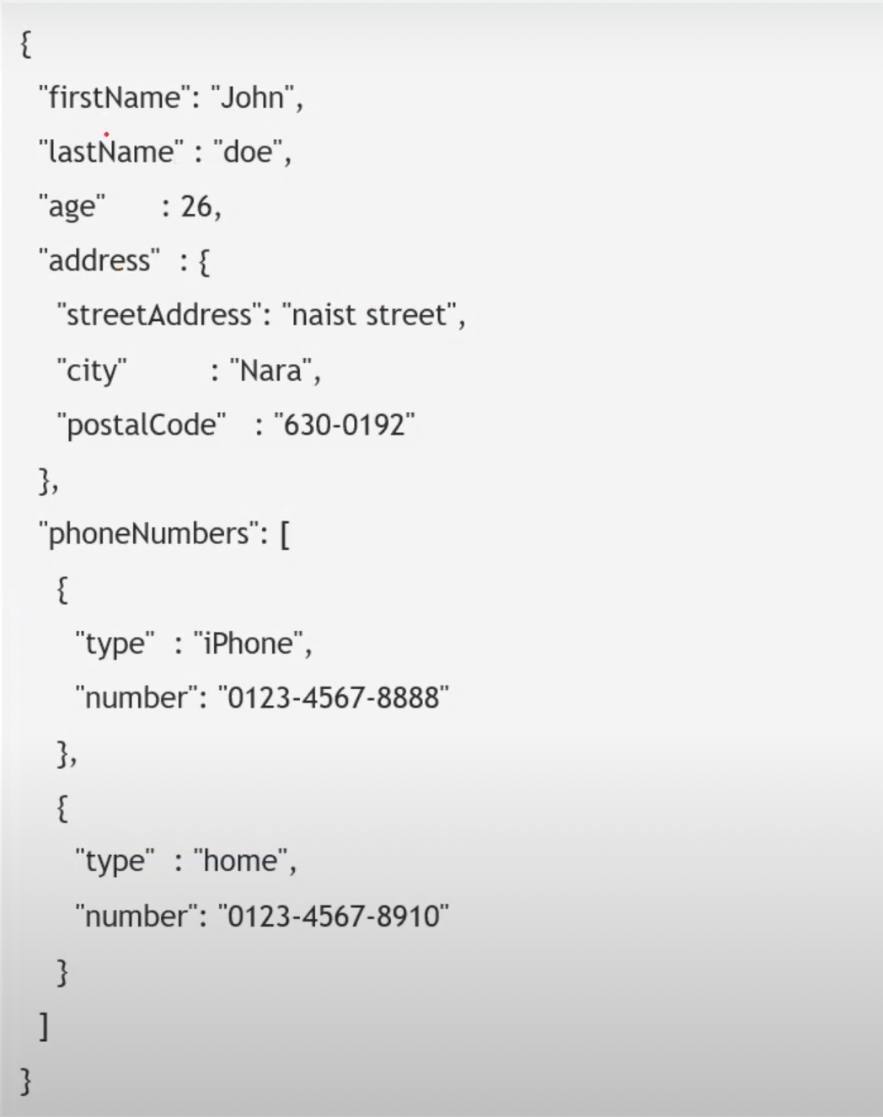
JSON Example

Slide 17
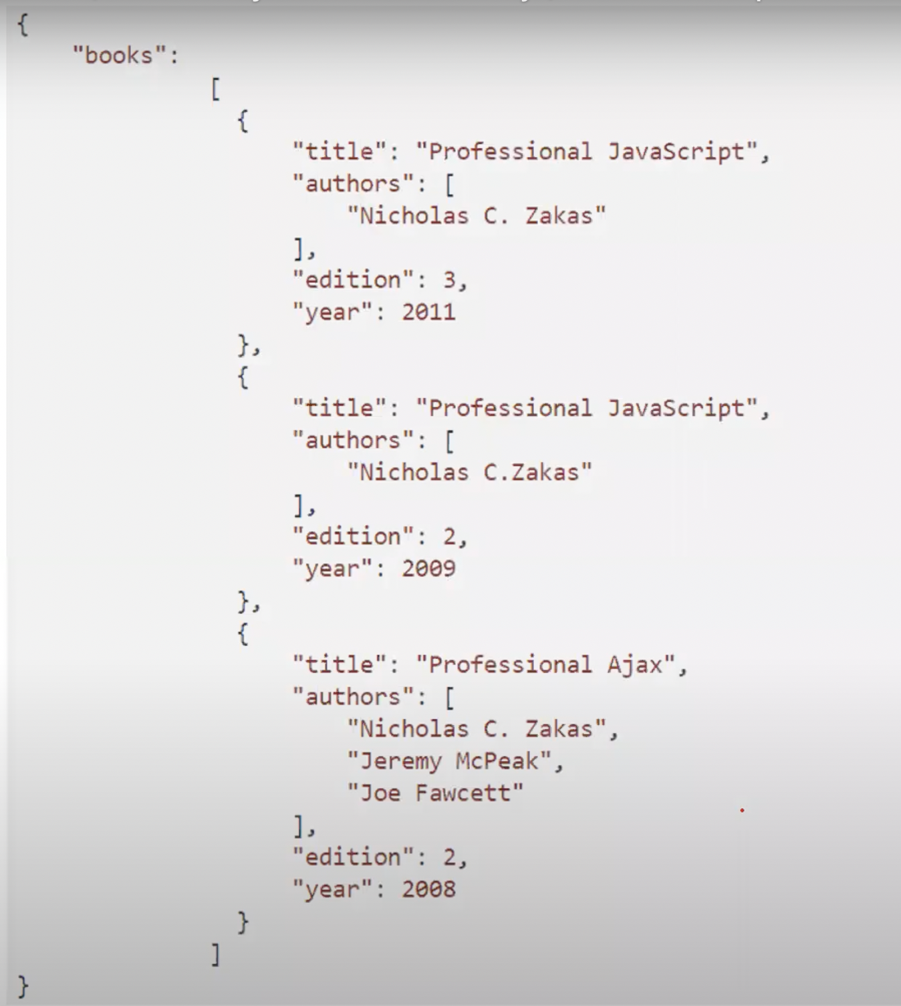
JSON Example

Slide 18
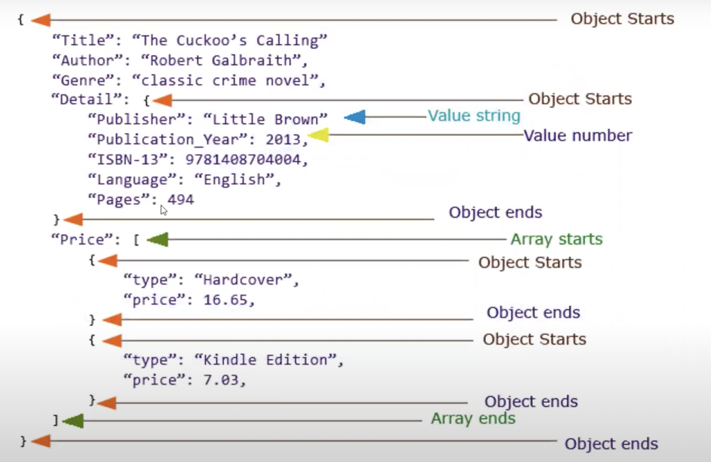
How to represent data in JSON

Slide 19
Retrieving data from JSON using JSON path
JSONPath is a query language for JSON , like Xpath for XML.
JSONPath Expression specifies a path to an element (or a set of elements) in a JSON structure.
Path can use the dot notation:
$.store.book[0].title
Or the bracket notation
$[‘store’] [‘book’] [0] [‘title’]
$ represents the root object or array and can be omitted.
For example $.foo.bar and foo.bar are the same
And so are $[0].status and [0].status

Slide 20
JSON Path Expressions
JSON path expressions, including property name and values, are case sensitive.
Unlike Xpath, JSONPath does not have operations for accessing parent or sibling nodes from the given node.

Slide 21
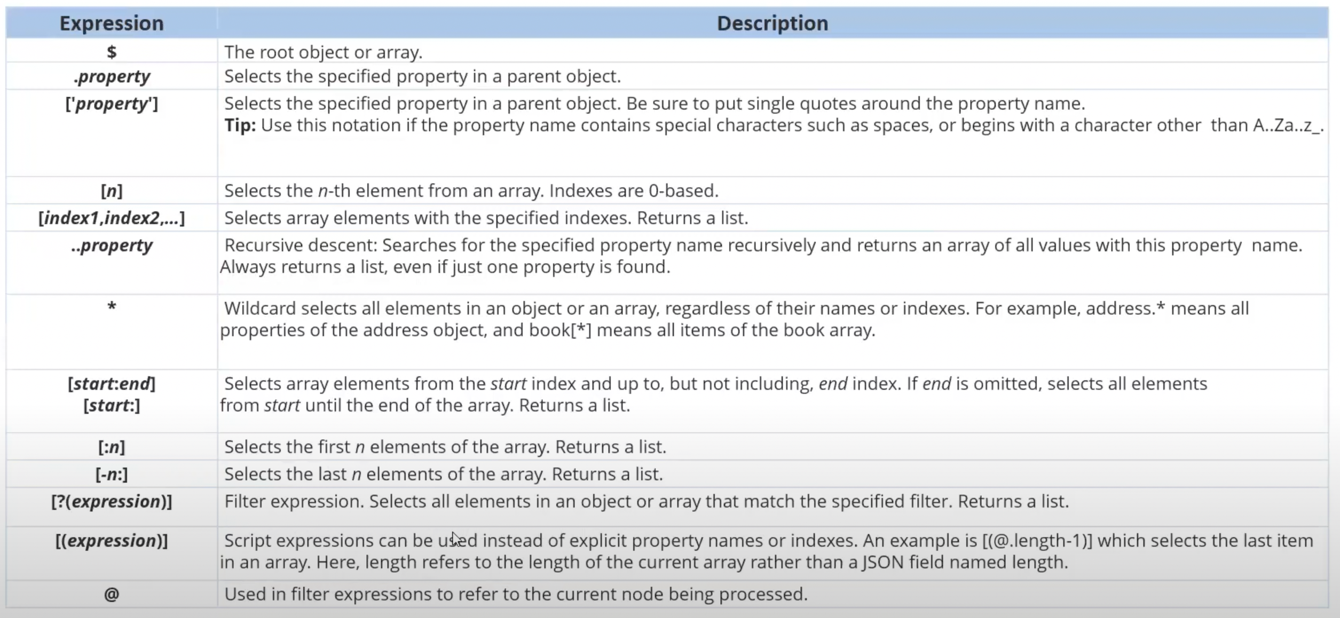
JSON Path Expressions

Slide 22
HttpClient
HttpClient is used for performing HTTP requests and responses.
The HttpClient service is available in the @angular/common/http package.
The new HttpClient service is included in Http client module which is used to initiate HTTP requests and response in Angular apps.
The HttpClientModule needs to be imported into the module, usually in the app module.
HttpClient also gives other useful functionality like interceptors, header etc.

Slide 23
HttpClient methods
get()
post()
put()
delete()
head()
jsonp()
option()
patch()

Slide 24
Benefits of HttpClient
It includes Observable APIs
It can have the Http header in options
It includes the highly testability features.
It includes request and response interception
It includes response object
It includes types request
It includes error handling

Slide 25
HttpClient GET Method
Making API calls to retrieve data is GET method call.
To make a call all we need is a end point or an API Url
get(‘api-endpoint’)
We can also pass various parameters options to the GET call
get(‘url’,options:{});
we will use options to pass parameters like headers, params, responseType, withCredentials etc
get(‘url’,options:{headers{},param{}});
The response type will be an observable
Whenever the response is observable, we have to subscribe to it in order to read values.

Slide 26
CRUD operations using HttpClient
Create : usually a post method call
Read : usually a get method call
Update: usually a put method call
Delete: is a delete method call

Slide 27
How to use HttpClient Get method
Import HttpClientModule in app module
Import HttpClient in service or component wherever we are making the Http request.
Inject the HttpClient in the constructor method of the class
Implement the GET method call
Import the services into the required calling component class
Call the method o make the HTTP request

Slide 28
Common POST Examples
Login Form
Create New User
Contact Form

Slide 29
How to use HttpClient POST method
Making API calls to submit the data is referred to as a POST call.
To make a call we need an endpoint or an API URL and data that needs to be submitted.
post(‘url’,body)
We can also pass various parameters as an options to the POST call
post(‘url’,body,options:{});
we will use options to pass parameters like headers, params, responseType, withCredentials etc
post(‘url’,body,options:{headers{},param{}});
The response type will be an observable
Whenever the response is observable, we have to subscribe to it in order to read values.

Slide 30
How to use HttpClient POST method
Import and add the HttpClientModule in app module
Import HttpClient in service or component wherever we are making the Http request.
Inject the HttpClient in the constructor method of the class
Implement the POST method call
Import the services into the required calling component class
Call the method o make the HTTP request

Slide 31
What are Observable
A subsequence of data which is emitted asynchronously over period.
Angular makes use of observables as an interface to handle a variety of common asynchronous operations.
An observable can deliver multiple values of any type – literals, messages, or events depending on the context.

Slide 32
What is an Observer
When we create an Observable , we keep track on the observable using Observer.
Observer is continuously listening to Observable
We can control when to start and end listening to the Observable using Observer.
Observer has 3 methods that we can use: next(), error() and complete()

Slide 33
Observables and Subscribe
Just having an Observable is waste if we DO NOT have any subscriber to it.
We must always subscribe to an observable in order to process the data.
We can have multiple subscribers for any given observables
We can also unsubscribe from a subscriber

Slide 34
services
Services allows us to create reusable common shared functionality between various modules and components.
Services are singleton.
Services are injected into application using Dependency injection mechanism
We need to create and inject services in components where we want to use them.
Services are an abstraction layer or process layer which consists of our application business logic.
Services are commonly used for making HTTP requests to our end points APIs to request and receive the response.
A service can have a value, methods or a combination of both.

Slide 35
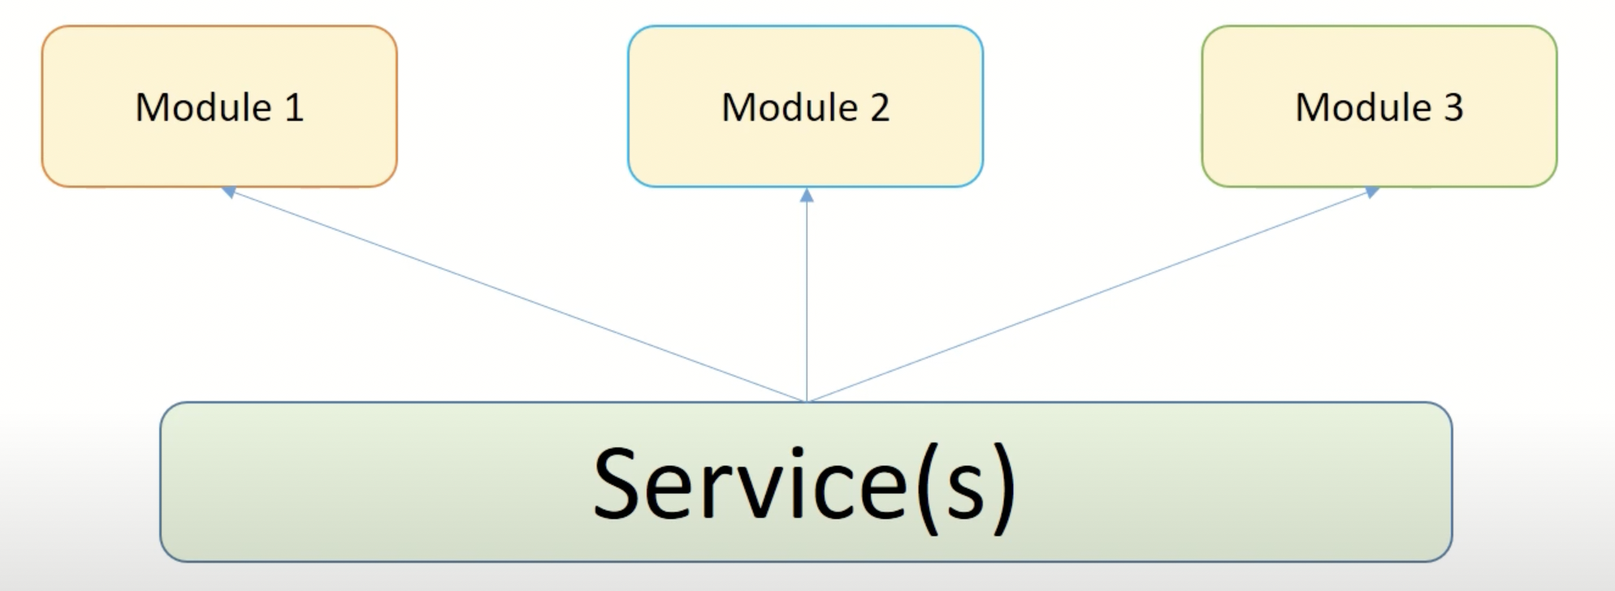
services

Slide 36
services
How to generate services using CLI
ng generate service <service_name>
import {injectable} from ‘@angular/core’

Slide 37
How to use services
Generate the service
Import the service in the component class
Initialize in the constructor method i.e Dependency Injection
Call the methods and properties in the class (component class) or
Call the methods directly in the template(html file)

Slide 38
Dependency Injection
Dependency Injection is a design pattern which has the ability to add the functionality of components at runtime.
The DI framework lets you supply data to a component from an injectable service class, defined in its own file.
Dependencies are services or objects that a class needs to perform its function.

Slide 39

Thank You

